Slide 1
AIoT-Based Mental Fitness Detection System
By:
K.Saketh Sai Srikar(CSM)
P.Rahul(CSM)
Dolphin Pilot(ECI)
P.Ashmith Nanda(CSM)
Under The Guidance Of:
Prof.T.Kishore Kumar
Head CTL

Slide 2
Introduction
Cognitive and physical impairment resulting from the consumption of substances may have hazardous repercussions when performing activities that involve driving, operating heavy machinery, or arriving at significant decisions. Conventional methods of detection basically utilize measurement of blood alcohol concentration (BAC) using tools such as breathalyzers. Since personal tolerance varies from one individual to another, BAC is insufficient to pinpoint an individual's mental competence. This work proposes an AIoT-multi-sensor system that measures a set of physiological and cognitive parameters to decide whether an individual is fit or not under the influence.

Slide 3
Literature Survey
While researching alcohol detection systems, I found that most existing solutions focus solely on measuring blood alcohol concentration (BAC) using a single sensor, usually a breathalyzer. One study, titled “A Lightweight In-Vehicle Alcohol Detection Using Smart Sensing and Optimizable Shallow Neural Network”, used an MQ-3 sensor and a shallow neural network to classify intoxication but didn’t consider the person’s actual mental state. Another paper, “A Transdermal Alcohol Sensing and Machine Learning-Based Model”, explored skin-based alcohol detection and highlighted how personal alcohol tolerance varies.
These studies made me realize a significant gap: most systems don’t evaluate the user’s mental or physiological fitness. They only report alcohol levels, which may not reflect actual impairment. This inspired me to develop a system that uses multiple sensors—like heart rate, SpO₂, GSR, and reaction time—along with AI to provide a more accurate, real-time assessment of mental fitness under alcohol influence.

Slide 4
Problem Statement
To develop a real-time AIoT-based mental fitness detection system that integrates alcohol sensing and biomedical signal monitoring (heart rate, SpO₂, GSR, reaction time), using an ESP32 and machine learning model to accurately assess a person’s cognitive fitness under the influence of alcohol and other medical or psychological conditions like stress or anxiety.

Slide 5
Novelty
Uses multi-sensor fusion (Alcohol, GSR, Heart Rate, SpO₂, and Reaction Time).
Employs AI-based classification model to determine "Fit" or "Unfit" rather than just reporting alcohol level.
Focuses on mental fitness, not just intoxication.
Designed as a low-cost, portable prototype suitable for vehicles, industries, or personal use.

Slide 6
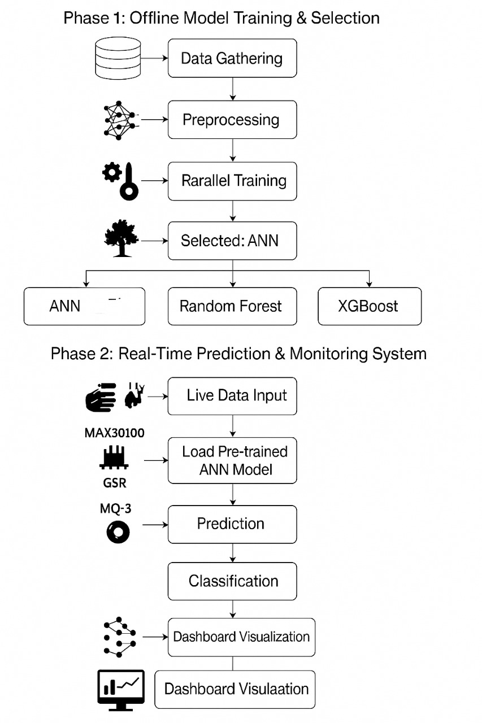
Algorithm

Slide 7
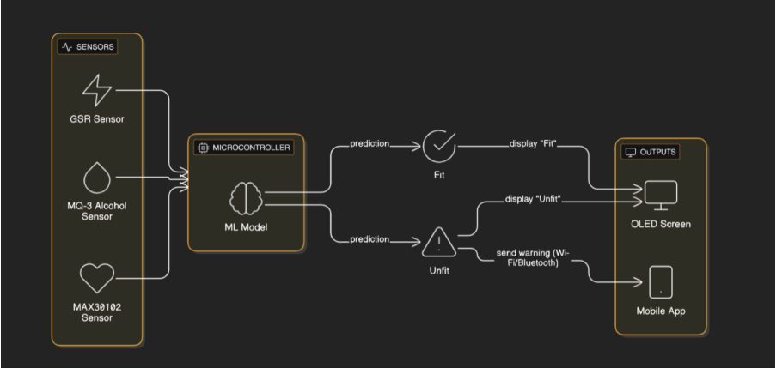
Block Diagram

Slide 8
Methodology
Sensor Setup
Data Collection
Simulate both “sober” and “intoxicated” conditions using realistic values.
Generate a dataset containing multiple readings labelled as “Fit” or “ Unfit”.
AI Model Training
Features: Alcohol level,GSR,HR,SpO2,reaction time.
Labels: 0 (Fit), 1 (Unfit)
Deployment
MQ-3 to detect alcohol vapour in breath.
MAX 30102 to monitor heart and SpO2.
GSR sensor to measure skin conductance.
Train using a shallow neural network.
Evaluate wit accuracy, confusion matrix
Integrate train model into Microcontroller or Raspberry Pi
Display results in real-time on OLED or mobile app.

Slide 9
Methodology
Step 1: Sensor Setup
MQ-3 to detect alcohol vapor in breath. MAX30102 to monitor heart rate and SpO₂. GSR sensor to measure skin conductance.
Step 2: Data Collection
Simulate both "sober" and "intoxicated" conditions using realistic values. Generate a dataset containing multiple readings labelled as "Fit" or "Unfit".
Step 3: AI Model Training Features
Alcohol level, GSR, HR, SpO₂, reaction time.
Labels: 0 (Fit), 1 (Unfit).
Train using a shallow neural network (or SVM/Random Forest for small devices). Evaluate with accuracy, confusion matrix.
Step 4: Deployment
Integrate trained model into microcontroller or Raspberry Pi.
Display results in real-time on OLED or mobile app.

Slide 10
Components
Component | Purpose
MQ-3 Sensor | Alcohol level detection
MAX30102 | Heart rate and oxygen level
GSR Sensor | Skin conductance(Stress)
ESP32/ Raspberry Pi | Microcontroller & ML inference
OLED Display / App | Display result or alert

Slide 11
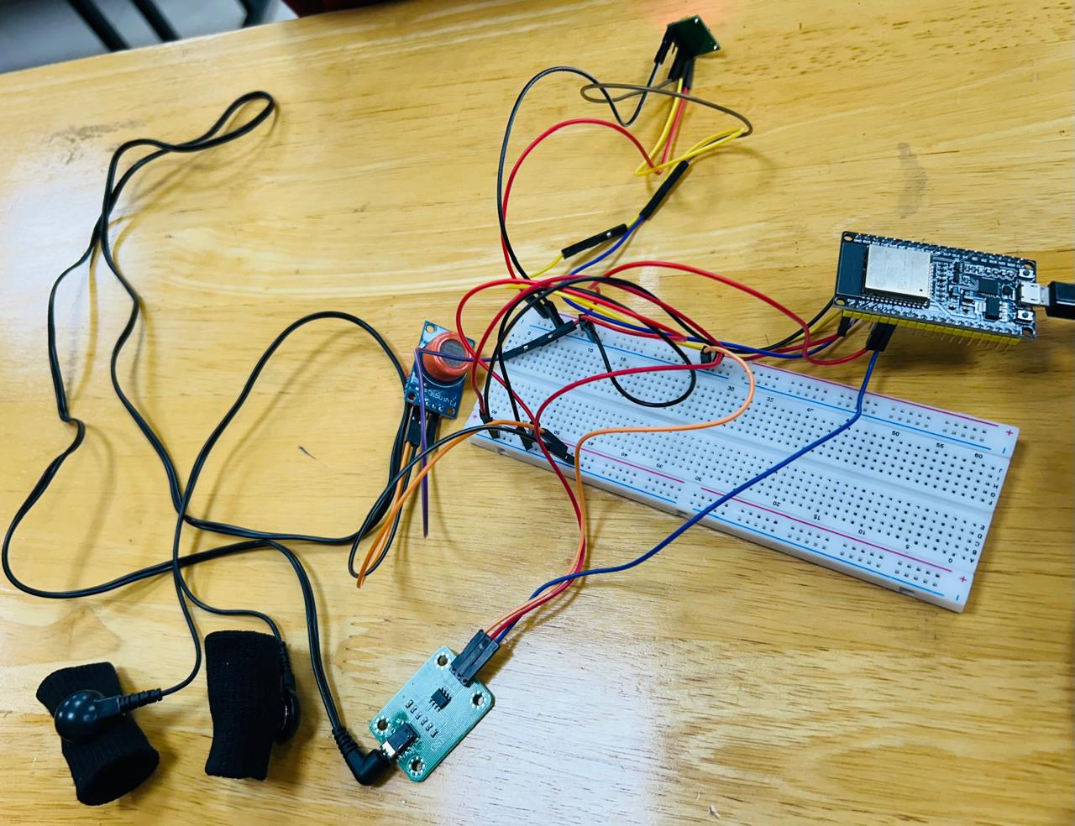
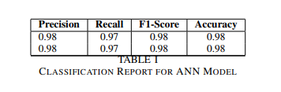
Evaluation and Observation
Connectivity

Slide 12
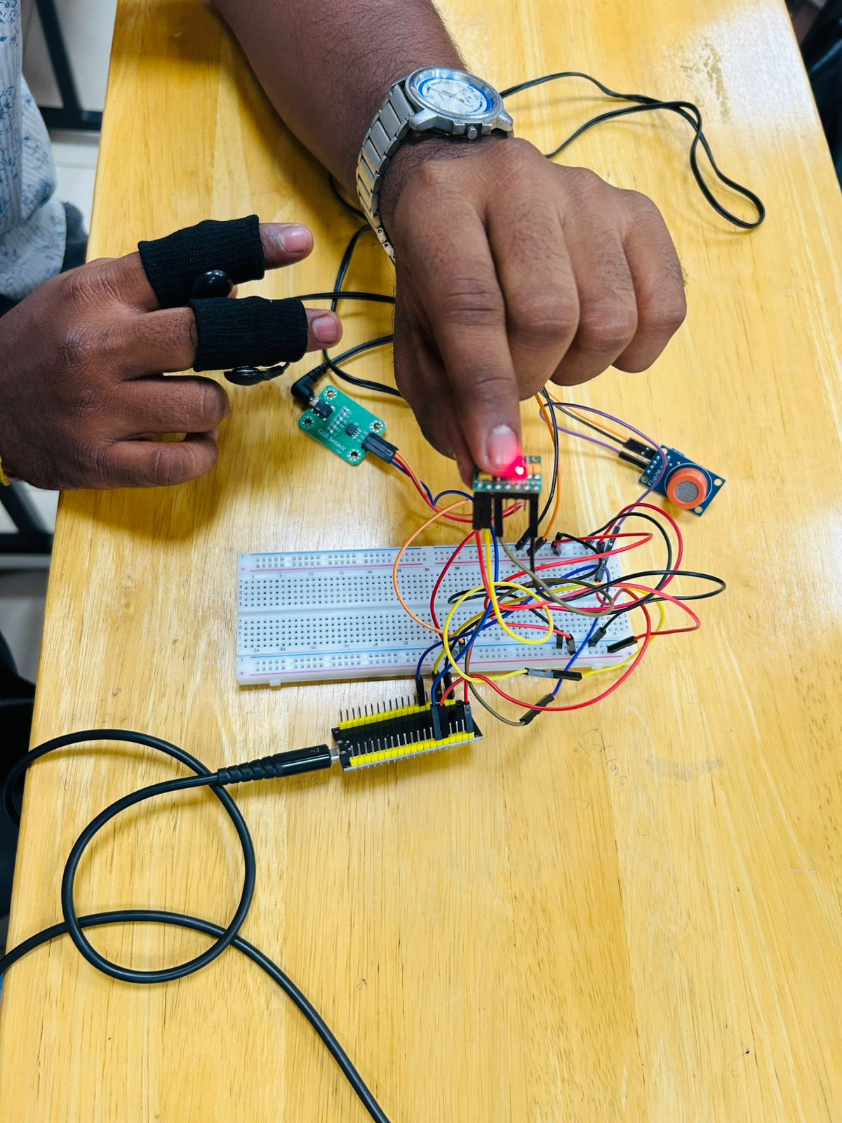
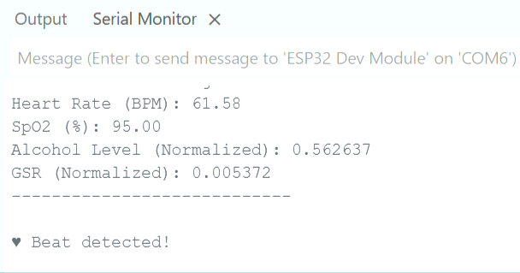
Testing And Results

Slide 13
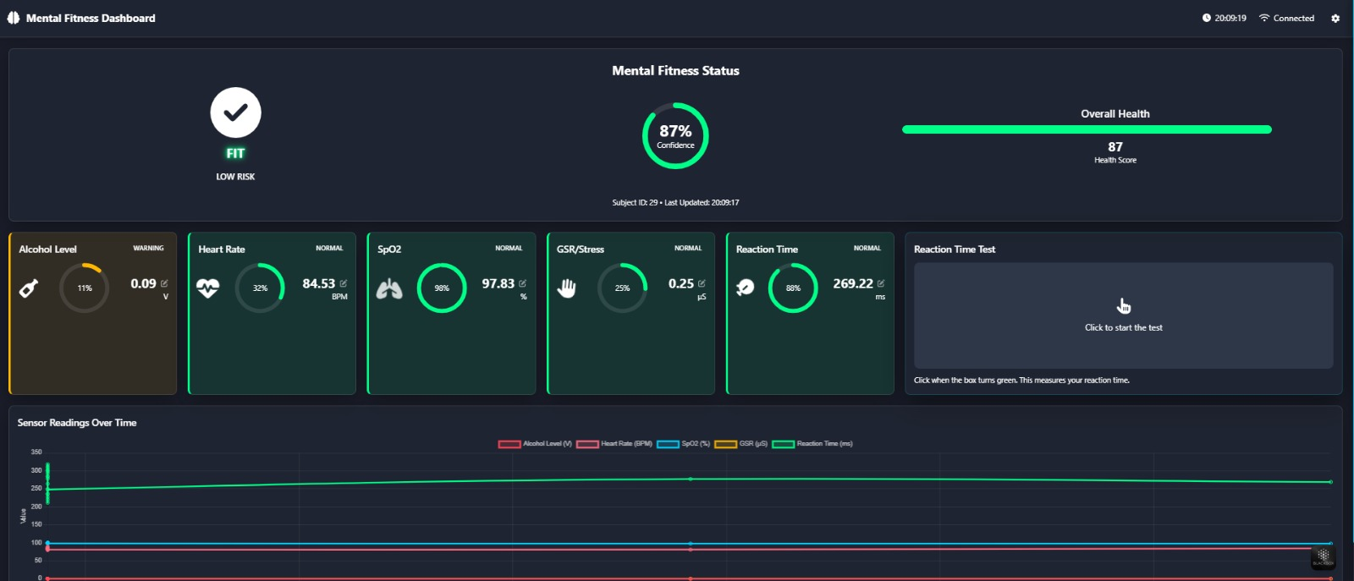
DashBoard

Slide 14
Applications
Driver Monitoring Systems – Prevent driving under mental impairment.
Industrial Safety Systems – Check workers mental fitness before operating machines.
Healthcare – Monitor patient alertness and fitness.
Personal Use – A home-based self-check kit for safety-conscious individuals.
Defense and Military – Fit-for-duty checks in critical missions

Slide 15
Conclusion
In a world where a single moment of impaired judgment can cost lives, this AIoT-based mental fitness detection system offers a novel and intelligent approach to evaluating an individual's cognitive and physiological state under the influence of alcohol. By integrating multiple sensors—such as alcohol, GSR, heart rate, SpO₂, and reaction time—and utilizing machine learning algorithms, the system goes beyond traditional alcohol detection methods that rely solely on BAC levels. It provides a comprehensive assessment of mental fitness, taking into account individual variability in tolerance and response. The solution is low-cost, portable, and adaptable for various applications, including driver monitoring, industrial safety, healthcare, and military readiness. Overall, this system holds great potential in enhancing public safety and promoting responsible decision-making in alcohol-influenced situations.

Slide 16
References
"A Lightweight In-Vehicle Alcohol Detection Using Smart Sensing and Optimizable Shallow Neural Network" (MDPI Computers 2022) Used MQ-3 sensors and an SNN to classify intoxicated states. Focused only on alcohol levels.
"A Transdermal Alcohol Sensing and Machine Learning-Based Model to Predict Alcohol Intoxication Level" (IEEE Access) Used skin-based alcohol sensing + ML models. Highlighted variability in personal alcohol tolerance.

Slide 17
THANK YOU

